Slide 1

Created by: JEEVAN PREM

Slide 2
A
B
c
D
E
Overview of the Dataset
Key Modules
Country and EC
Child Mortality
Health Systems
The Country module in the dataset lists various countries along with their economic conditions.
Discuss exports, imports, income levels, and GDP
Insights on child mortality rates across countries.
Highlight countries with high and low rates.
Analysis of health Systems as of per-capita and its impact on life expectancy.
Metrics to understand HealthCare and Impact on Healthcare outcomes.
The dataset allows for comparisons and analyses of how different countries perform in different areas.
Showing us into their health systems, economic conditions, and development.
Country
Child Mortality
Exports
Health Systems

Slide 3


Slide 4



KEY MODULES
CHILD MORTALITY
HEALTH SYSTEMS
COUNTRY
EXPORTS
This has lists various countries along with economic, allowing us to see their health and economic condition.
Child mortality refers to the number of children who die before their fifth birthday, usually measured per 1,000 live births.
Exports are the goods and services that a country sells to other countries, contributing to its economy.
Health systems are the organized efforts and resources of a country to deliver healthcare services to its population.

Slide 5

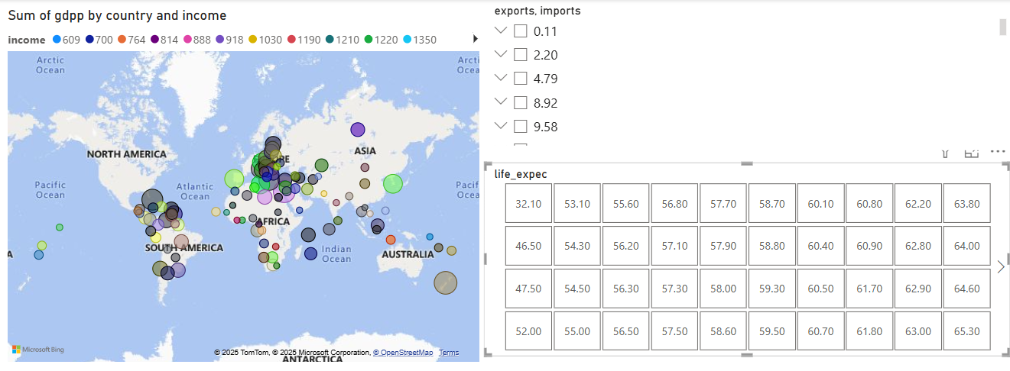
ECONOMIC CONDITIONS IN DIFFERENT COUNTRIES
To Show the Economic and social conditions in the world. I Used the Map Chart to represent the Average GDP of every Country.Also Added Slicers for imports and exports along with Life expectancy rate.

Slide 6

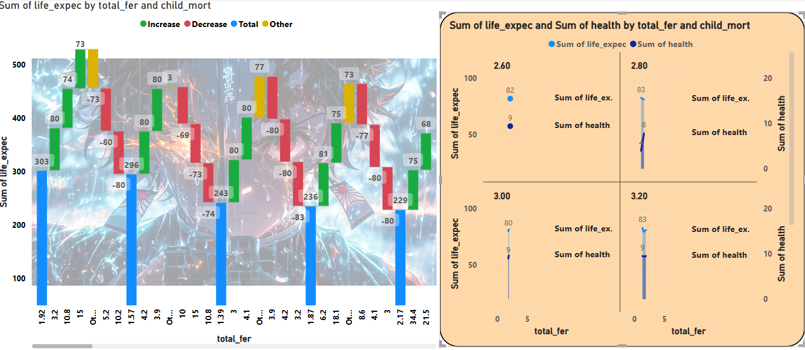

Slide 7
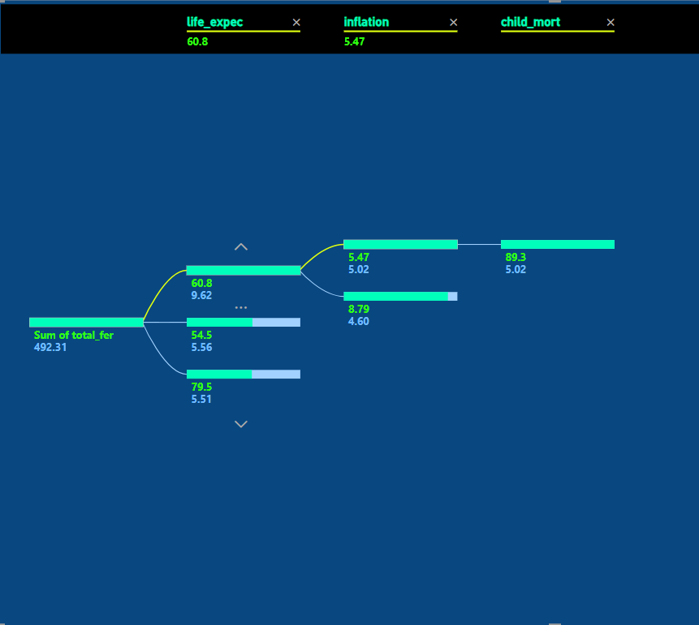
HEALTH SYSTEMS
The data shows as the countries with higher health systems have lower child mortality rates, with better healthcare to the children. Also, life expectancy and total fertility rates tells us the progress of health systems
I used Decomposition Tree chart to show how the progress is.
Overall, the dataset highlights the interconnectedness of economic factors and health system performance.
By analyzing child mortality rates, health expenditure, life expectancy, and other conditions, I can tell the strengths and weaknesses of various countries healthcare systems.

Slide 8
CONCLUSION
The map chart and slicers helped us see how different countries are doing economically, showing clear differences in income levels and trade activities.
Using the waterfall and area charts, we could track child mortality rates alongside total fertility and life expectancy, highlighting where improvements are needed.
The decomposition tree chart gave us a deeper look into health systems, breaking down factors like fertility rates, life expectancy, and health expenditure, which all play a role in child mortality.
Overall, the data shows that investing in healthcare can lead to better outcomes for children. Countries with better health systems tend to have lower child mortality rates and higher life expectancy.

Slide 9



